Slide 1
RecSys Project
Matteo Gläser, Ilyas Satik, Sonja Dagn

Slide 2
Important Step: Data Simplification
Free Combination of all kinds of gameplay-mods leads to in theory endless „items“
Filtered out all rows where difficulty/map/pp altering Mods were used, except for the competetively viable (and most common) ones.
Merged all "preference" mods if used, that change gameplay only a little into the remaining 4 main categories:
- NM(No Mod)
- DT(Double Time),
- HR(Hard Rock),
- DTHR(Double Time + Hardrock)
4. treat each beatmap_id + Mod_string combination as a unique item and assign a new "item id":mod_beatmap_id
50.000 to 200.000 items
Retained around 80% of Scores.
Reduction of features and organization into User, Beatmap and Score Table

Slide 3
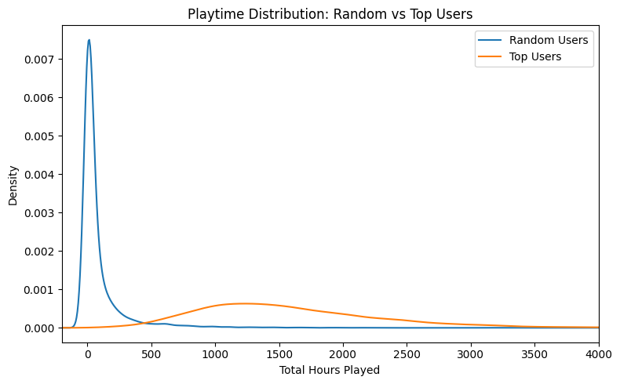
User Analysis – Playtime Distribution
Random Users (blue curve)
extremely concentrated near zero playtime
Top Users (orange curve)
much wider spread
peak around 1300 hours
logged substantially more total playtime

Slide 4
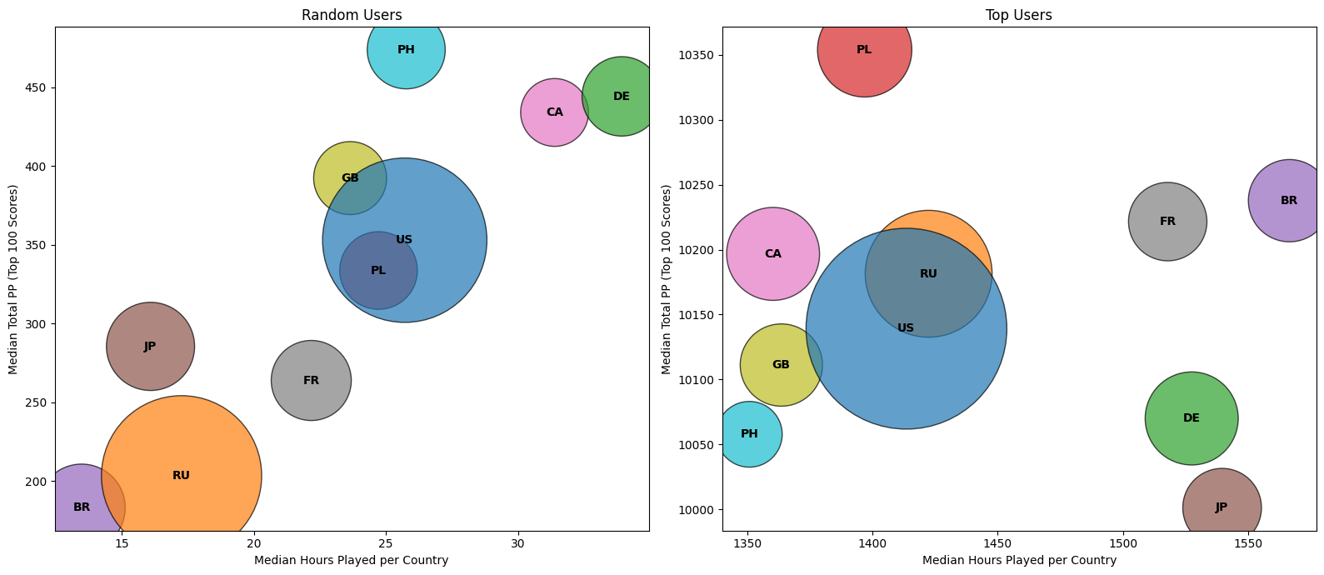
User Analysis – Countries on the Leaderboard
Bubble size: Amount
X: Total PP weighted
Y: Median Hours played
Biggest Shifters:
BR – Brazil
DE – Germany
PH – Philippines
CA - Canada
Attention, for random users
Is an insufficient sample size

Slide 5
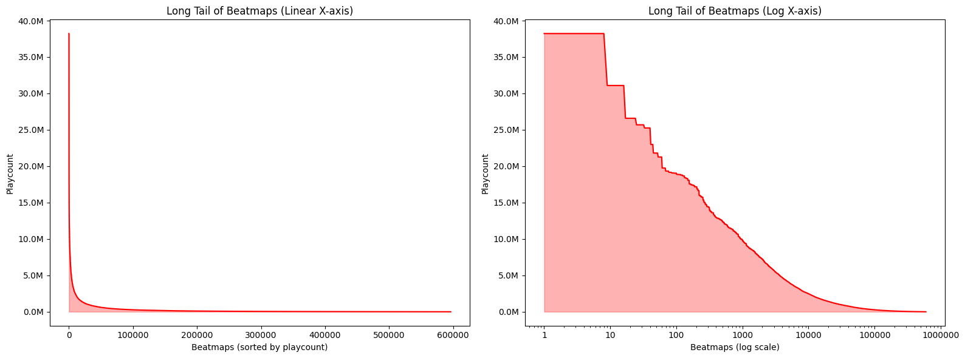
Beatmap Analysis – Long Tail of Beatmaps
Items normal
Items logarithmic

Slide 6
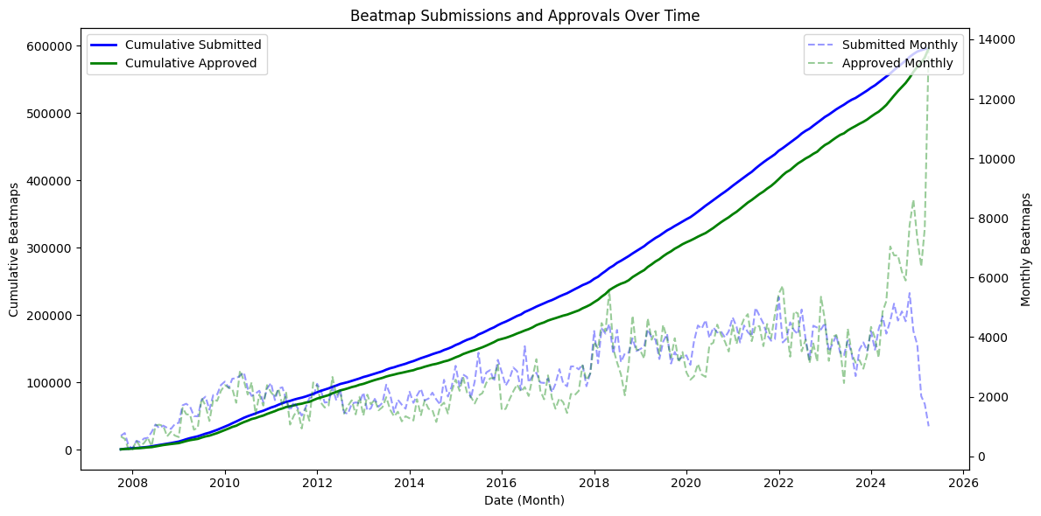
Beatmap Analysis – Number of Beatmaps over Time
Launch in 2008:
new beatmap submissions rose quickly
From 2010–2016
map creation fluctuated between ~1 500 and 3 000 monthly
Late 2017
sharp surge ,peaking around 5 000–6 000 monthly
likely driven by increased player activity and tooling improvements
Between 2019–2022
monthly submissions stabilized around 3 000–5 000
occasional spikes
Starting in 2023
dramatic uptick occurred
By early 2025
7 000 - 10 000 new maps per month
indicating renewed growth in community mapping

Slide 7
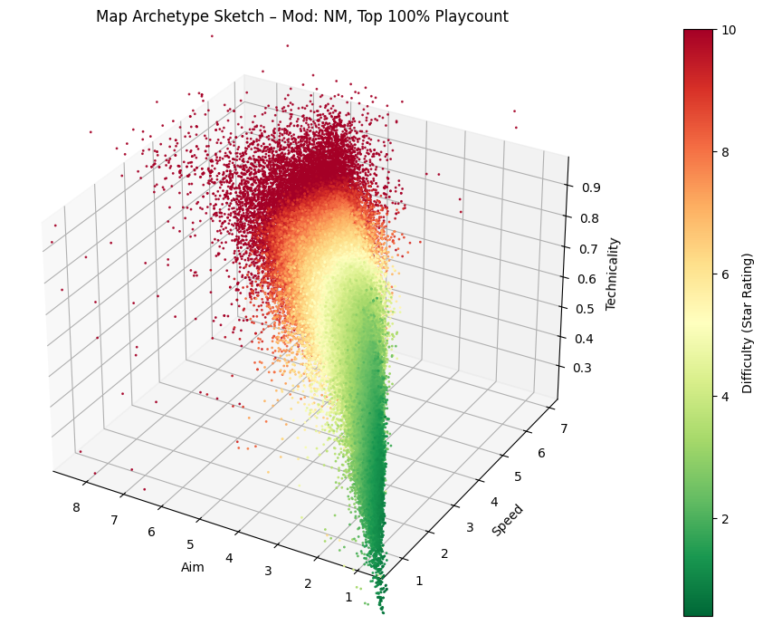
Beatmap Analysis – aim, speed, „technicality“, with difficulty rating
Takeaways:
- Cone shape expected, BUT
We expected more Clustering in higher difficulties.
Map „Archetypes“ not easily identifiable through basic constructed metrics.
Maybe just more Hybrids Maps out there then expected.

Slide 8
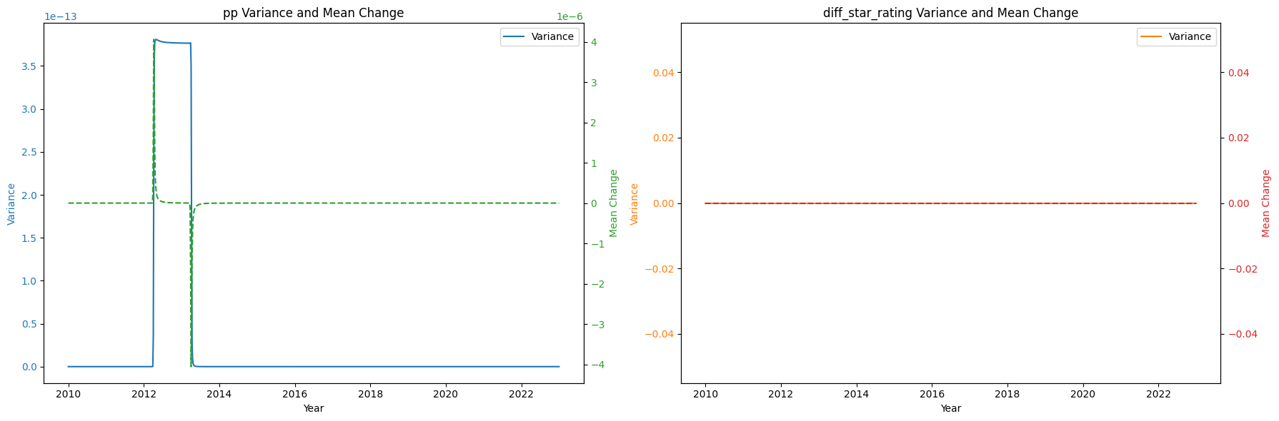
Score Analysis – Temporal Volatility: Performance‐Point vs. Star‐Rating
Performance Point (left)
the variance of changes (solid blue) spikes dramatically around 2012, collapses by 2014, and thereafter remains essentially zero—indicating a brief period of extreme fluctuation followed by long‐term stability
The mean change in pp (dashed green) mirrors these bursts, peaking when variance peaks and settling back to nearly zero once volatility subsides
Star-Rating (right)
both the variance (orange) and mean change (red) of star‐rating differences remain flat at zero throughout 2010–2023—showing that star ratings themselves have been highly stable with no measurable year‐to‐year drift

Slide 9
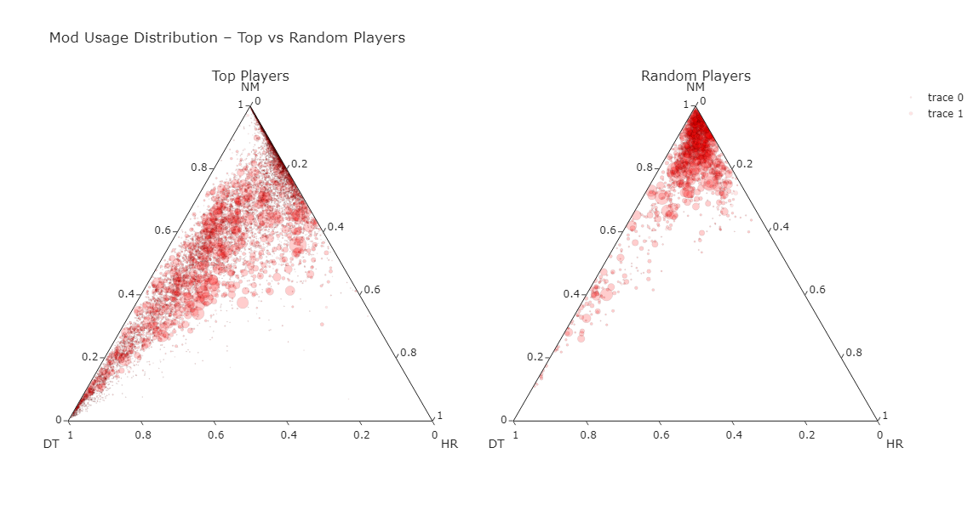
Score Analysis – Mod Usage
NM
Beatmaps Fractions of Mods used ,
Top players use way more mods
Maps exclusively played in DT and NM but not for HR
DT more popular than HR
Circle Size: beatmap playcount
DT
HR
TOP Players
Random Players

Slide 10
Score Analysis – Skill constraint estimates over time for a random user.
Dotted lines: constraint estimates
Dots: Scores performed in timeframe
Color: Score accuracy
Sspeed
aim
For any give chunk notice:
Rather sharp cut off to the right of distributions,
Points beyond the dotted are quite red usually
approach rate
star_diff

